Slide 1

The 7Th IET GCC Robotics Challenge
Saudi Local Round,
(8 – 9) November 2023
An Online Event

Slide 2
SKYBOTICS
Team Members: Mirna Ali, Aicha Sidiya , Razan Almahdi
Advisor: Dr. Nema Salem
Effat University, KSA

Slide 3
Table of Content
01
04
Problem Statement
Challenges
02
05
Proposed Solution
Conclusion
03
06
Results
References

Slide 4
Problem Statement
The manual systems for check-in and navigation in airports can cause confusion, delays, and missed flights. The main causes of customer dissatisfaction are:
Long queues during the check-in process
The need for assistance and navigation guidance

Slide 5
Proposed Solution: Airport Assistance Robot
Scan passport, verify and validate user through airport database, and baggage drop off
Navigates passengers to boarding gate, shopping areas, restaurants, and baggage area using sensors, GPS, and Google API
Provide tailored assistance and information to passengers using a recommendation system powered by a chatbot that communicates with the user through speech using Google API
Notes:
ggag

Slide 6
HARDWARE & SOFTWARE

Slide 7
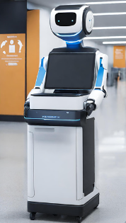
Proposed Solution: Airport Assistance Robot
Camera
Speaker & Microphone
Passport Scanner
LCD Screen
Credit Card Reader
Printer
DC Motor
Notes:
tance ass

Slide 8
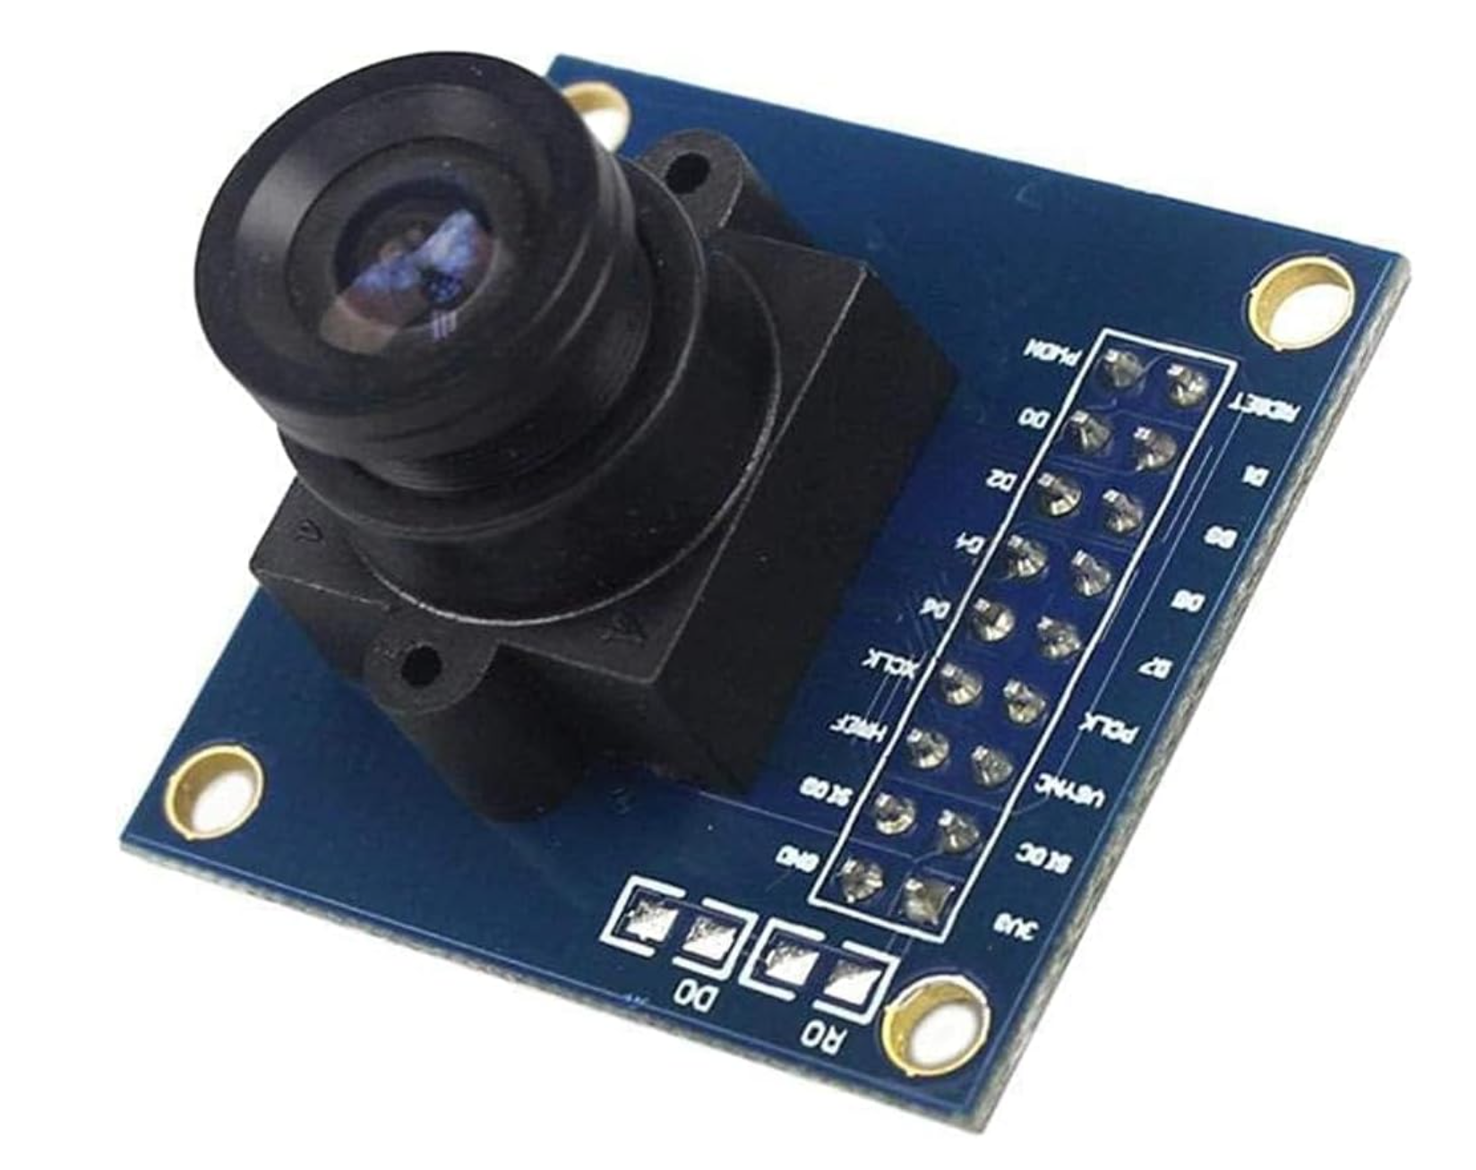

OV7670 Camera Module
LCD Screen
Provides real-time depth and color data
Continuously analyze the environment
Detects obstacles and avoids them
Interaction user interface
Displays prompts, selection options, and other informations
Real-time updates of data
Notes:
Real-time data streaming: The camera provides real-time depth and color data, allowing the robot to continuously analyze the environment and make decisions accordingly.
necessary tools and APIs for obstacle detection and avoidance.
An LCD screen (Liquid Crystal Display) provides visual output capabilities for displaying text, graphics, and user interfaces. Some of the features and benefits of an LCD screen in terms of GUI (Graphical User Interface) include:
Text Display: LCD screens can display alphanumeric characters, allowing for the presentation of textual information such as messages, prompts, or menu options.
Graphics Display: LCD screens can also display simple graphics, icons, or symbols, enabling the creation of visual elements in the user interface.
User Interaction: LCD screens can be used in conjunction with input devices (such as buttons or touch panels) to provide interactive user interfaces. Users can navigate through menus, select options, or input data using the screen.

Slide 9
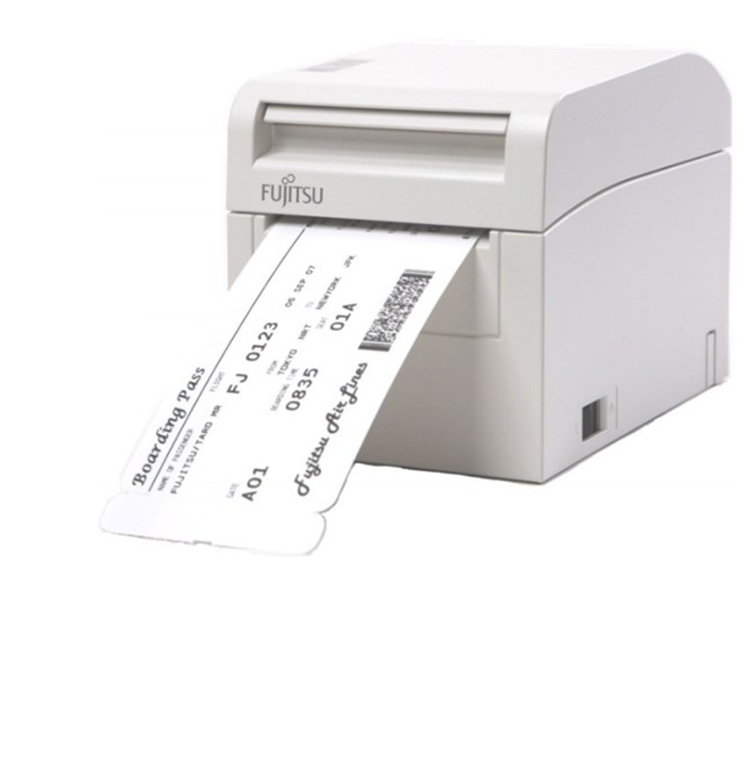
FUJITSU F9860 Printer
Max9814 microphone & Speaker
Compatible and high performance printer
Prints boarding pass, baggage tag, and receipt
A speaker converts written text into spoken words
Microphone converts sound waves into electrical signals and this can be converted to text using speech recognition

Slide 10
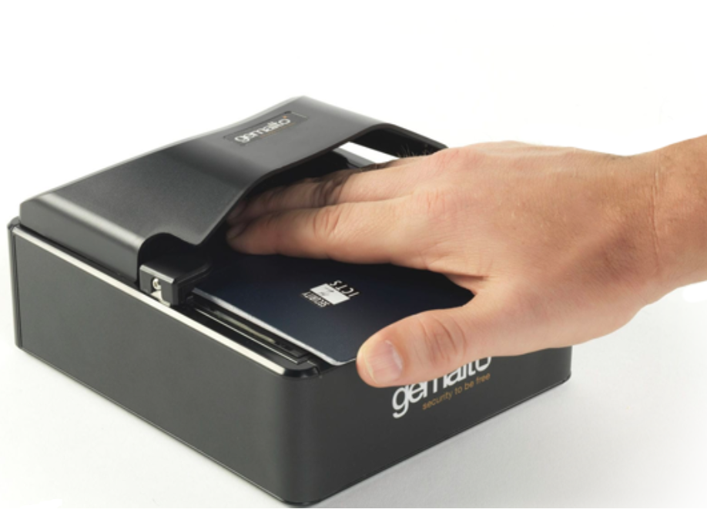
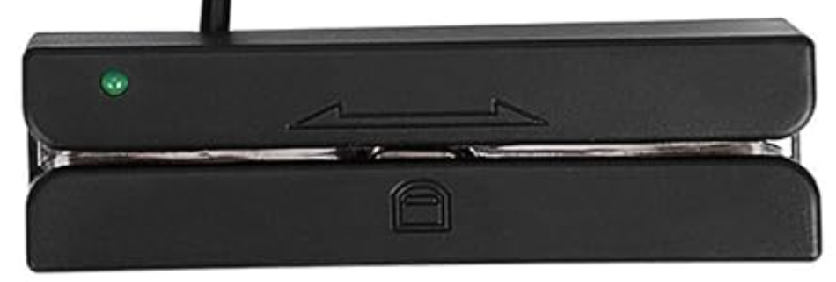
Passport Scanner
Credit Card Reader (ETEKJOY Magnetic Stripe Card Reader)
Scanner extracts information of passenger from the machine-readable zone (MRZ)
OCR algorithms identifies and segments the characters
Data is compared against databases for verification
Reads the magnetic strip or chip on credit card
Data is transmitted and processed in the system
Provides transaction between the user and payment processing system
Notes:
Real-time data streaming: The camera provides real-time depth and color data, allowing the robot to continuously analyze the environment and make decisions accordingly.
necessary tools and APIs for obstacle detection and avoidance.
An LCD screen (Liquid Crystal Display) provides visual output capabilities for displaying text, graphics, and user interfaces. Some of the features and benefits of an LCD screen in terms of GUI (Graphical User Interface) include:
Text Display: LCD screens can display alphanumeric characters, allowing for the presentation of textual information such as messages, prompts, or menu options.
Graphics Display: LCD screens can also display simple graphics, icons, or symbols, enabling the creation of visual elements in the user interface.
User Interaction: LCD screens can be used in conjunction with input devices (such as buttons or touch panels) to provide interactive user interfaces. Users can navigate through menus, select options, or input data using the screen.

Slide 11
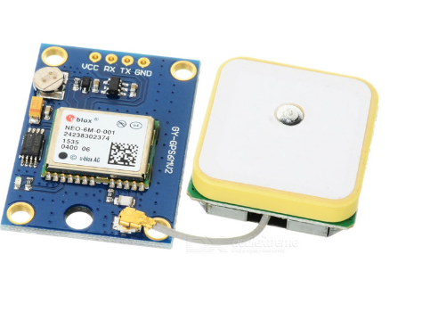
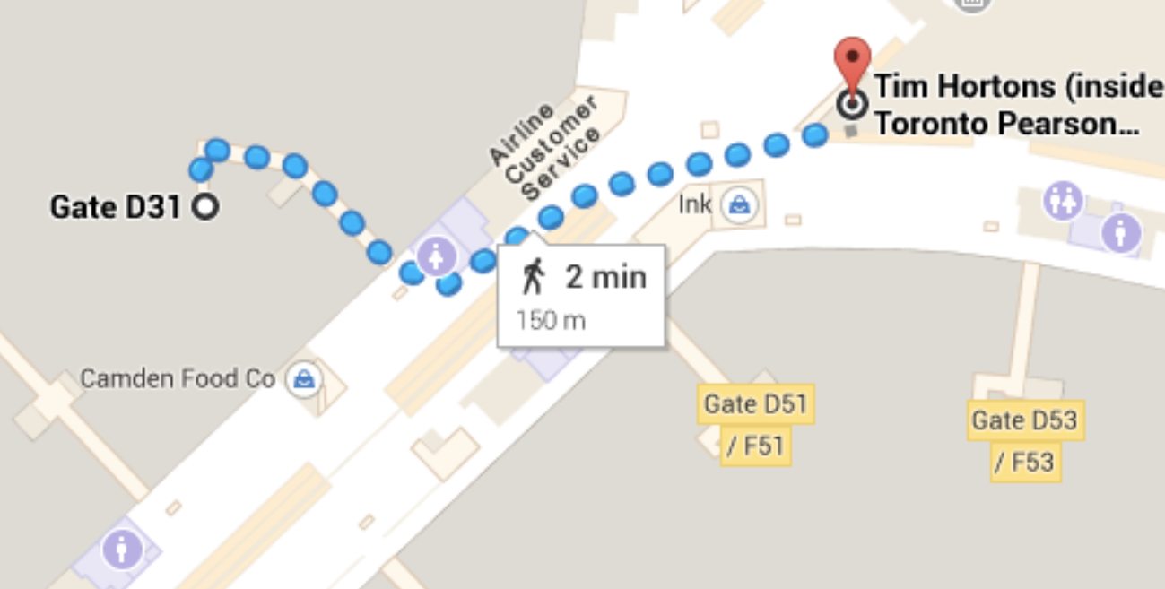

NEO-6M GPS module is a satellite-based navigation system that provides robots with precise location and time information
Google Maps API provides a set of tools and services that can be integrated in the system
GPS determines the current position of the robot and the Google Maps API will obtain map data for that location.
Google Maps API's routing functionality will take into account factors such as shortest distance.

Slide 12
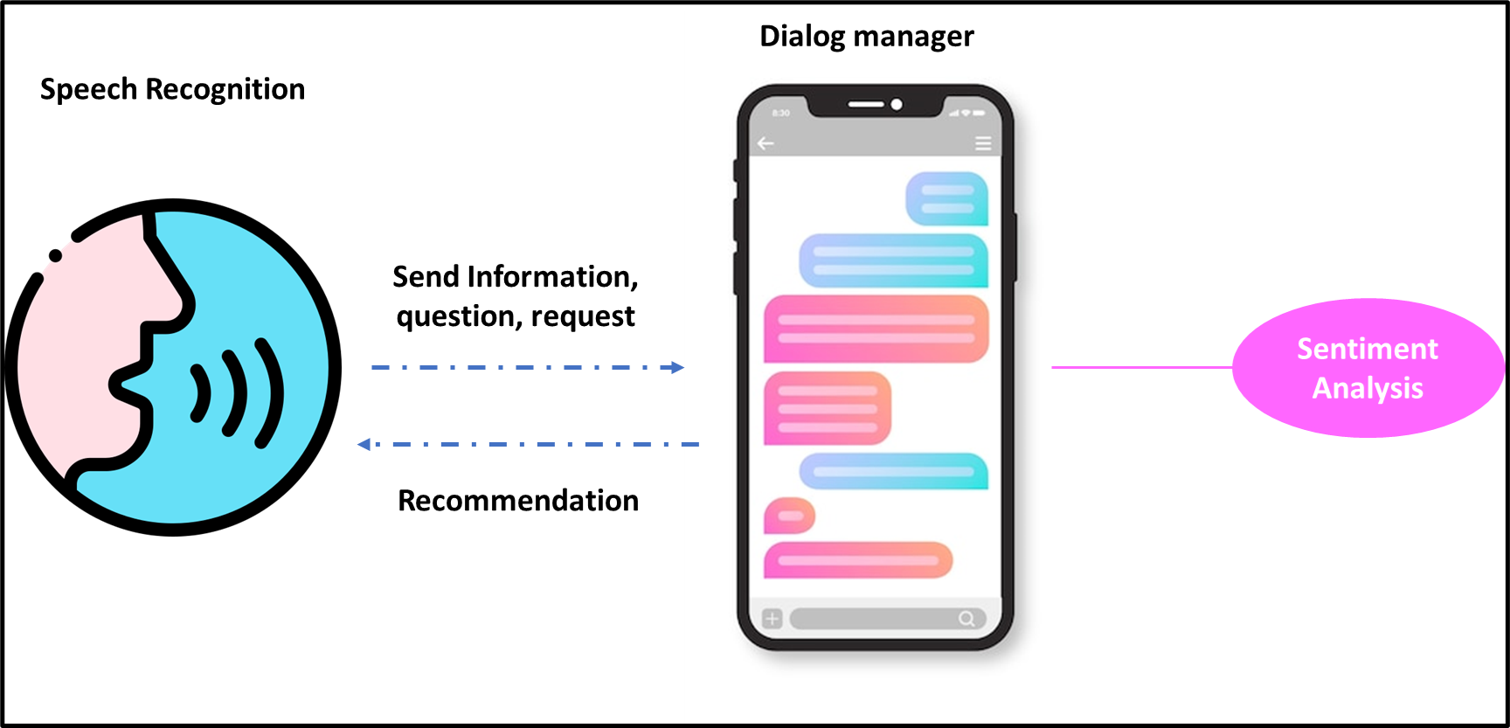
Speech Recognition: Build a natural language processing model capable of generating human like responses using libraries like speech_recognition in python, Google's library to perform text-to-speech recognition, and DialoGPT-medium model with transformers to build the conversation pipeline.
Sentiment Analysis: The chatbot can use NLTK SentimentIntensityAnalyzer to analyze the sentiment of the user's feedback.
Recommendation System: The final output using data collected from the conversation, and the Google Maps API, the robot will be able to suggest the best facilities for the user by cross checking the available choices in Google Maps with user preference.

Slide 13
RESULTS

Slide 14


Slide 15
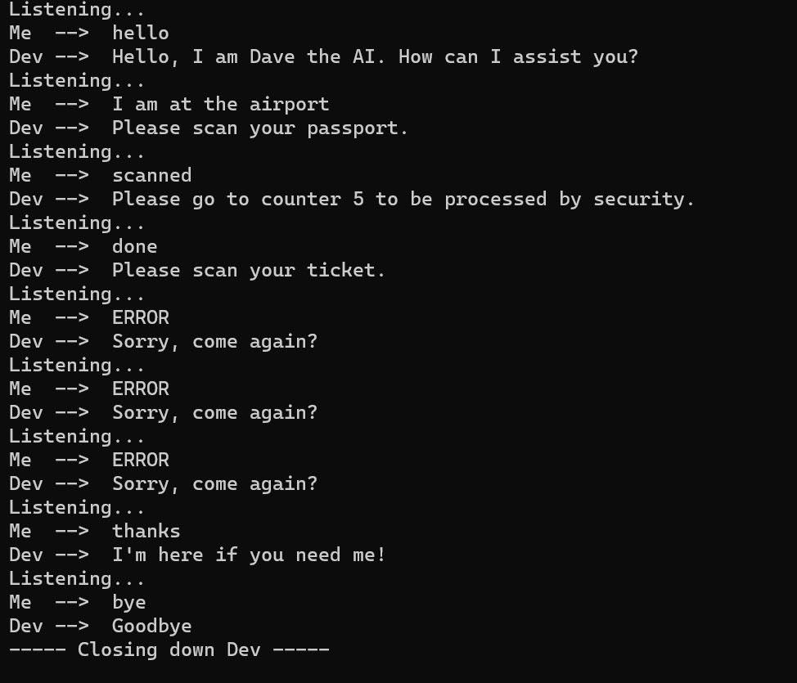

Slide 16
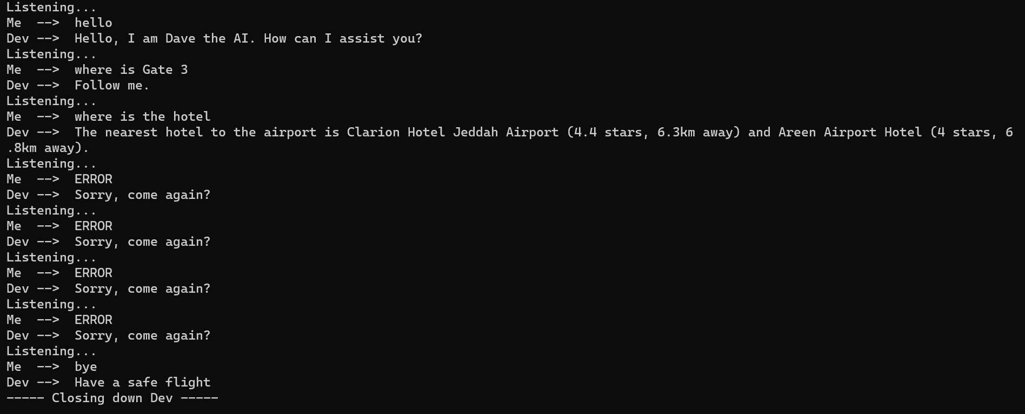

Slide 17
Challenges
Complex and costly system to deploy
Requires regular maintenance, update, and repair
The robot must be in compliance with regulations, safety standards, and data privacy laws

Slide 18
Conclusion
Airports have been causing confusion, delays, and missed flights. The proposed system verifies passengers during check-in process and provides navigation and information assistance throughout the passenger journey to improve their travel experience

Slide 19
References
https://mobilesyrup.com/2014/10/06/googles-indoor-maps-now-available-at-pearson-airport/

